Slide 1



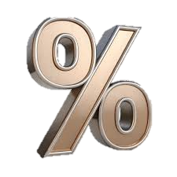
Funding the Leasing Industry:
Innovative Capital Solutions in an Era of Elevated Interest Rates
Prepared by:
SAMTL Research
Presenter:
Dr. Patrick Ejumedia
Head of Research
Sterling Asset Management & Trustees Ltd (SAMTL).
Date:
Thursday 9th July 2026

Slide 2
OUTLINE
Why Leasing is More Critical Than Ever
Growth of Nigeria's Leasing Industry
Industry Structure and Funding Gap
Current Funding Structure of Nigeria’s Leasing Industry
Nigerian Macroeconomic Landscape
Opportunities Despite Elevated Rates
Innovative Capital Raising Instruments
Alternative Funding Sources
Innovative Funding Models
What Investors Want
Recommendations
Closing Remark

Slide 3
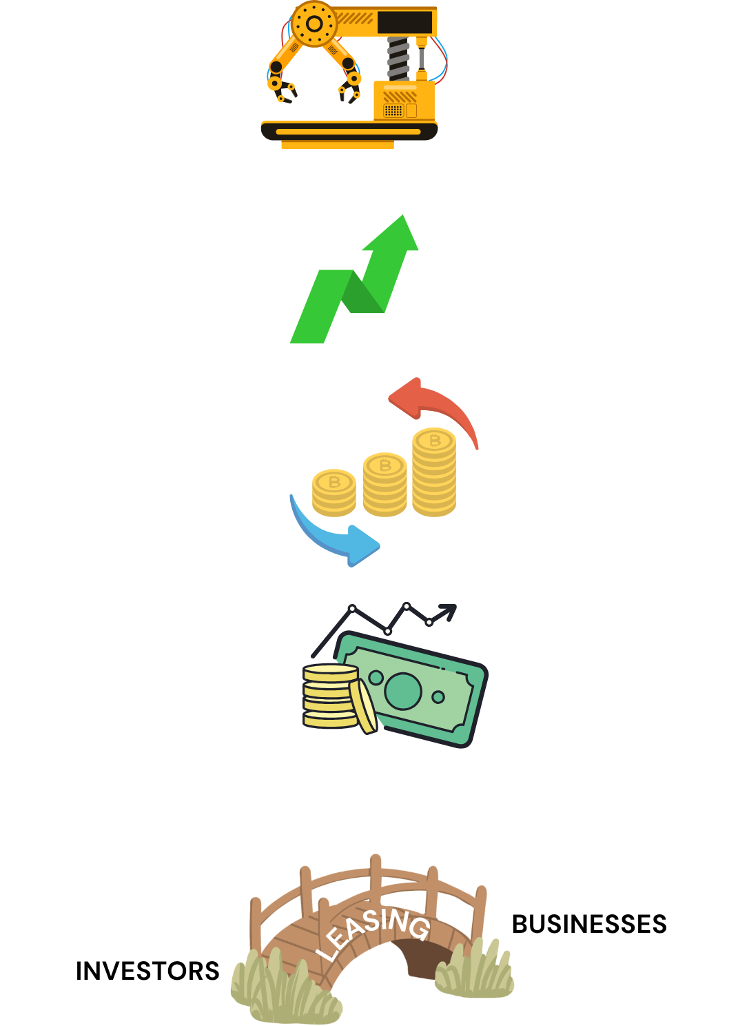
Why Leasing is More Critical Than Ever
Expands access to productive assets by financing equipment businesses may not be able to purchase outright.
Addresses financing gaps created by elevated interest rates and tighter credit conditions.
Improves corporate financial flexibility through off-balance-sheet financing and lower ownership costs – depreciation and Maintenance
This is the key messages
Supports economic productivity by enabling investment in machinery, vehicles, technology, and infrastructure.
Connects capital to the real economy, making leasing a vital transmission channel between financial markets and productive enterprises.
The challenge is not the demand for leasing—it is the availability of affordable, long-term funding.

Slide 4

Growth of Nigeria's Leasing Industry in Nigeriacc
Sustained growth in leased asset volumes over the past decade.
Indicator | Highlight
Outstanding Lease Volume 2025 | 6.54 trillion Naira
Industry Growth Rate 5-year CAGR | 50%
Number of Leasing Companies | Less than 200
Major Sectors | Manufacturing, Agriculture, Healthcare, Logistics & Transportation, Construction, Energy, Telecommunications
Market Penetration | Still relatively low compared with emerging markets Less than 1%
Demand for leasing continues to rise despite higher financing costs.
Major Drivers
Rising equipment costs
Infrastructure development
SME financing gap
Manufacturing expansion
Digital economy
Renewable energy investments
Healthcare expansion
Agricultural mechanization

Slide 5
Growth of Nigeria's Leasing Industry
Increasing adoption of equipment leasing across key sectors.
New Leases by Sector (2021 – 2025) (N' 000)
Sector | 2021 | 2022 | 2023 | 2024 | 2025
 | N’Billion
Manufacturing | 375.97 | 476.77 | 607.75 | 734.28 | 865.51
Transport & Logistics | 614.05 | 761.9 | 977.08 | 1181.47 | 1582.8
Agriculture | 176.23 | 218.55 | 300.75 | 387.62 | 478.61
Oil & Gas | 739.28 | 893.85 | 1127.74 | 1380.8 | 1580.78
Government | 154.87 | 201.91 | 267.4 | 345.27 | 412.38
Telecoms | 232.6 | 299.8 | 374.65 | 462.25 | 596.48
Others | 294.78 | 409.03 | 540.01 | 686.01 | 1020.84

Slide 6
Growth of Nigeria's Leasing Industry Cont’d
Sector Concentration
Funding Gap
High Interest Rates
FX Risk
Growth Opportunities
Heavy exposure to a few industries
Economic downturns in dominant sectors can significantly affect lease performance.
Short-term funding for long-term leases
Funding mismatches limit the ability of leasing firms to support large-ticket transactions.
Increase lease pricing and reduce demand
SMEs are particularly affected.
Most equipment is imported
Naira depreciation increases acquisition costs and lease rentals
Agriculture mechanization
Healthcare equipment
Renewable energy
Education infrastructure
ICT and digital infrastructure
Mining
Affordable housing equipment

Slide 7
Industry Structure and Funding Gap
Ownership Structure in the Leasing Industry
Ownership
Geographic Presence
Mostly privately owned firms
Founder-driven businesses/ family-owned businesses
Few institutional shareholders
Partnerships
very few publicly listed firms
Lagos dominates
Abuja & Port Harcourt secondary hubs
Limited penetration outside major commercial centres
Market Composition
Listing Status
Few Independent leasing firms dominate
Few bank-affiliated leasing companies
Mostly SMEs
Smaller firms have weaker balance sheets and higher funding costs.
Virtually no listed leasing companies
Limited access to equity investors
Geographical Distribution of Leasing Firms in Nigeria
Industry Characteristics: Private ownership + limited public listing + market concentration = constrained access to long-term capital.
Customer Base
Corporate organizations, SMEs, government agencies and multinationals

Slide 8
Leasing firms
Commercial bank loans
Shareholders capital
Development Finance Institutions
Retained Earnings
Capital Market Funding
Vendor Financing
Current Funding Structure of Nigeria's Leasing Industry
Current funding is dominated by short- to medium-term bank borrowings and promoter capital, while long-term capital market funding remains largely underdeveloped.
Short-term Borrowing
Equity From Owners
Limited capacity for expansion
Internal Cash flow
Slow capital accumulation
DFIs/Development
Credit Line
Limited access and stringent eligibility
Equity
Corporate Bonds
Commercial Papers
Very Limited

Slide 9
Current Funding Structure of Nigeria’s Leasing Industry - Funding Gap
Current Funding Structure
High Interest Cost
Limited Industry Growth
Heavy Dependence on Bank Loans
Need for Innovative Capital Solutions
Asset–Liability Mismatch
Long-term assets
funded by
short-term liabilities
IMPLICATIONS
Refinancing risk
Rising funding costs
Margin compression
Reduced capacity to finance new leases
Slower industry growth

Slide 10
Nigerian Macroeconomic Landscape
Growth recovering
Greater stability
Moderating but still elevated
Liquidity remains elevated

Slide 11

Nigerian Macroeconomic Landscape Key Highlights
GDP growth remains modest (~4%), indicating the need for stronger investment and private sector expansion.
Lower interest rates would support economic growth, investment, and leasing activity.
Inflation remains above the CBN's comfort level, limiting the scope for monetary easing.
Exchange rate stability remains a key policy priority, requiring a cautious monetary stance.
Pre-election fiscal spending is expected to increase liquidity within the financial system.
Excess liquidity could intensify inflationary and exchange rate pressures if left unchecked.
The CBN is likely to continue liquidity sterilization (OMO/CRR) to contain inflation and protect the naira.
Result: Interest rates are likely to remain elevated despite the need to stimulate economic growth.
Nigeria’s macroeconomic challenge is balancing growth with price and exchange rate stability. Until inflation moderates sustainably, monetary policy is likely to remain restrictive, keeping funding costs elevated for leasing companies.

Slide 12
Opportunities Despite Elevated Rates
High interest rates create opportunities for
Periods of constraint often create the greatest opportunities for innovation.
Asset-backed lending
Vendor financing
Infrastructure leasing
Green leasing
Healthcare equipment
Solar leasing
Agricultural mechanization
Digital equipment financing
Opportunities exist through:
Better funding mix
Portfolio diversification
Capital market solutions
Technology
Partnerships
Securitization
ESG finance
Innovation
Structured financing
Asset-backed funding
Does High Interest Mean No Opportunity?
Absolutely NOT.

Slide 13

Innovative Capital Raising Instruments
Traditional
Bank Loans
Modern
Commercial Paper
Corporate Bonds
Medium-Term Notes
Securitization
Asset-Backed Securities
Green Bonds
Infrastructure Bonds
Sukuk

Slide 14

Alternative Funding Sources
Development Finance
AfDB
IFC
BOI
AFC
Export Credit Agencies
Blended Finance
Institutional Investors
Pension Funds
Insurance Companies
Private Capital
Private Equity
Venture Capital
Family Offices

Slide 15
Innovative Funding Models
1
2
3
4
5
Vendor Financing
Sale & Leaseback
Warehouse Financing
Receivable Discounting
Co-Lending
6
7
8
Risk Sharing
Blended Finance
Embedded Finance

Slide 16
What Investors Want
Investors no longer chase only yield.
Strong governance
Predictable / Stable cash flow
Portfolio quality / Diversification
ESG Compliance
Technology
Strong collections
Low default rates
Management Quality
They seek

Slide 17


Recommendations
Leasing Firms
Diversify funding
Improve collections
Strengthen governance
Lengthen funding tenor
Improve asset quality
Build strategic partnerships
Improve ESG reporting
Improve risk management
Adopt technology
Regulators
Deepen capital market Promote securitization
Tax incentives
Credit enhancement
Guarantee schemes
Strengthen leasing law

Slide 18
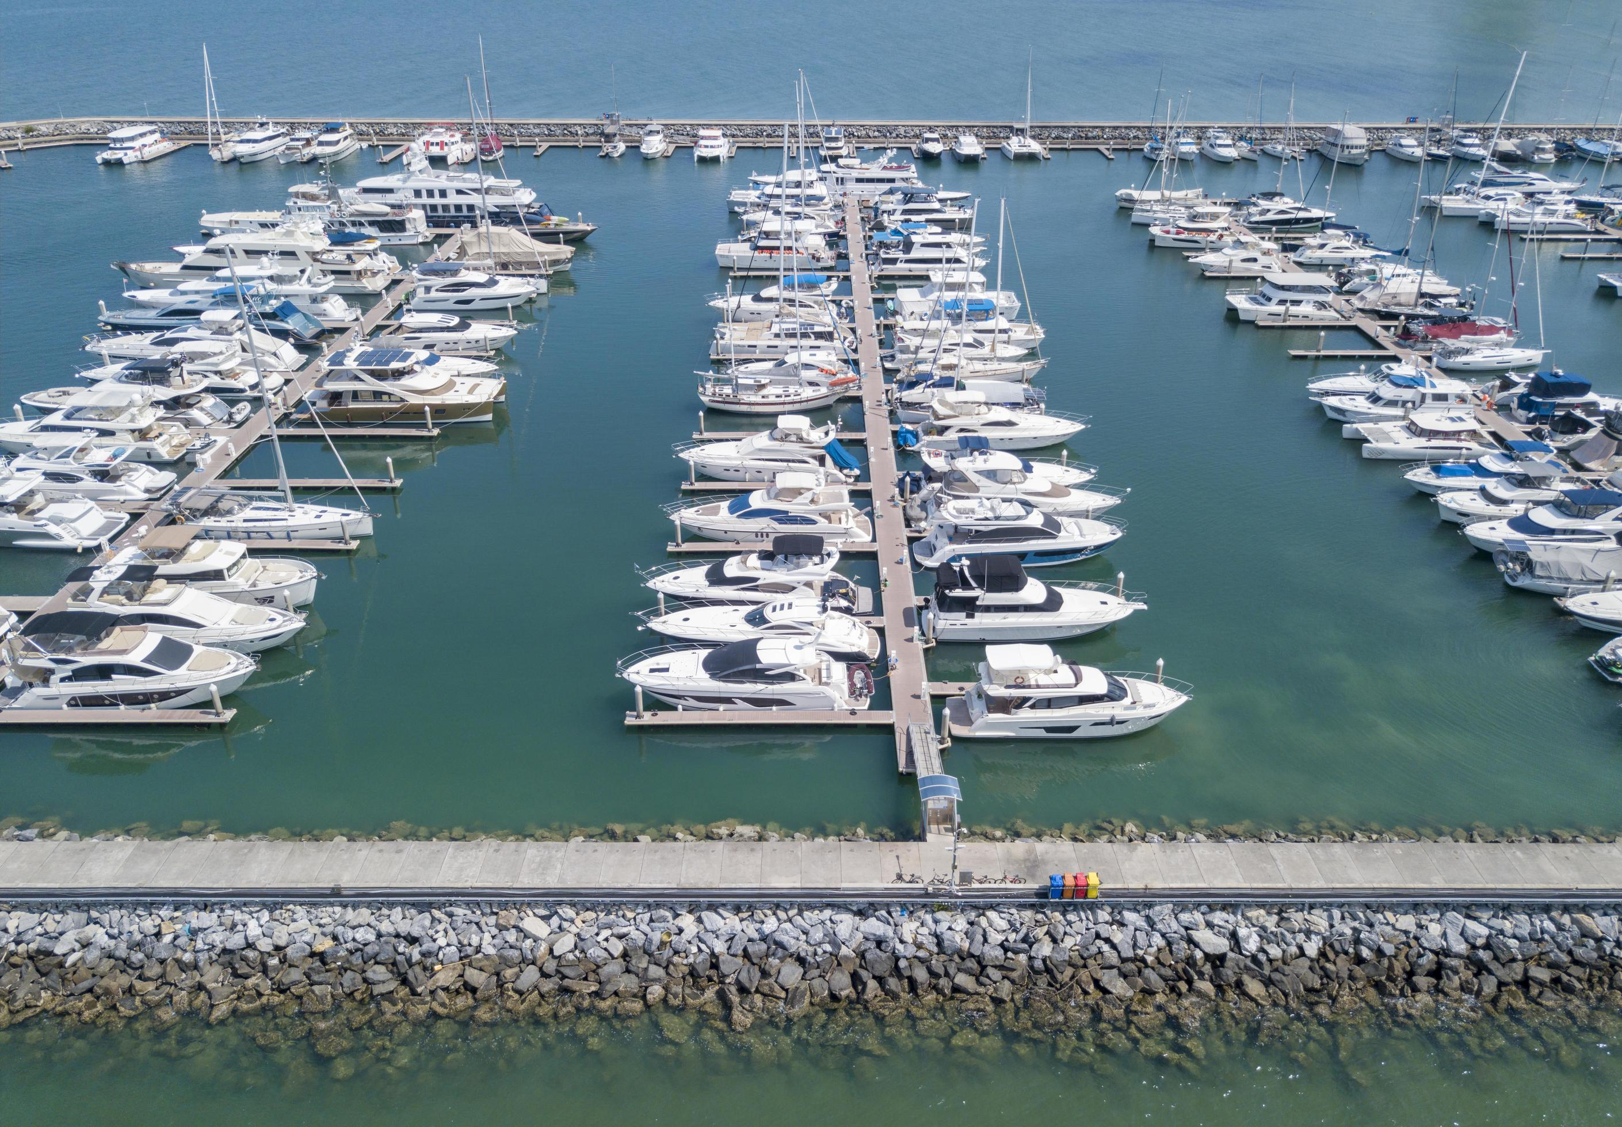
Closing Remark
The challenge facing the leasing industry today is not a shortage of opportunities but the rising cost of capital.
Firms that innovate in funding structures, strengthen risk management, diversify funding sources, and leverage capital market solutions will not merely survive this era of elevated interest rates—they will emerge stronger, more resilient, and better positioned to finance Nigeria's next phase of economic growth

Slide 19
THANK YOU FOR YOUR ATTENTION

