Slide 1
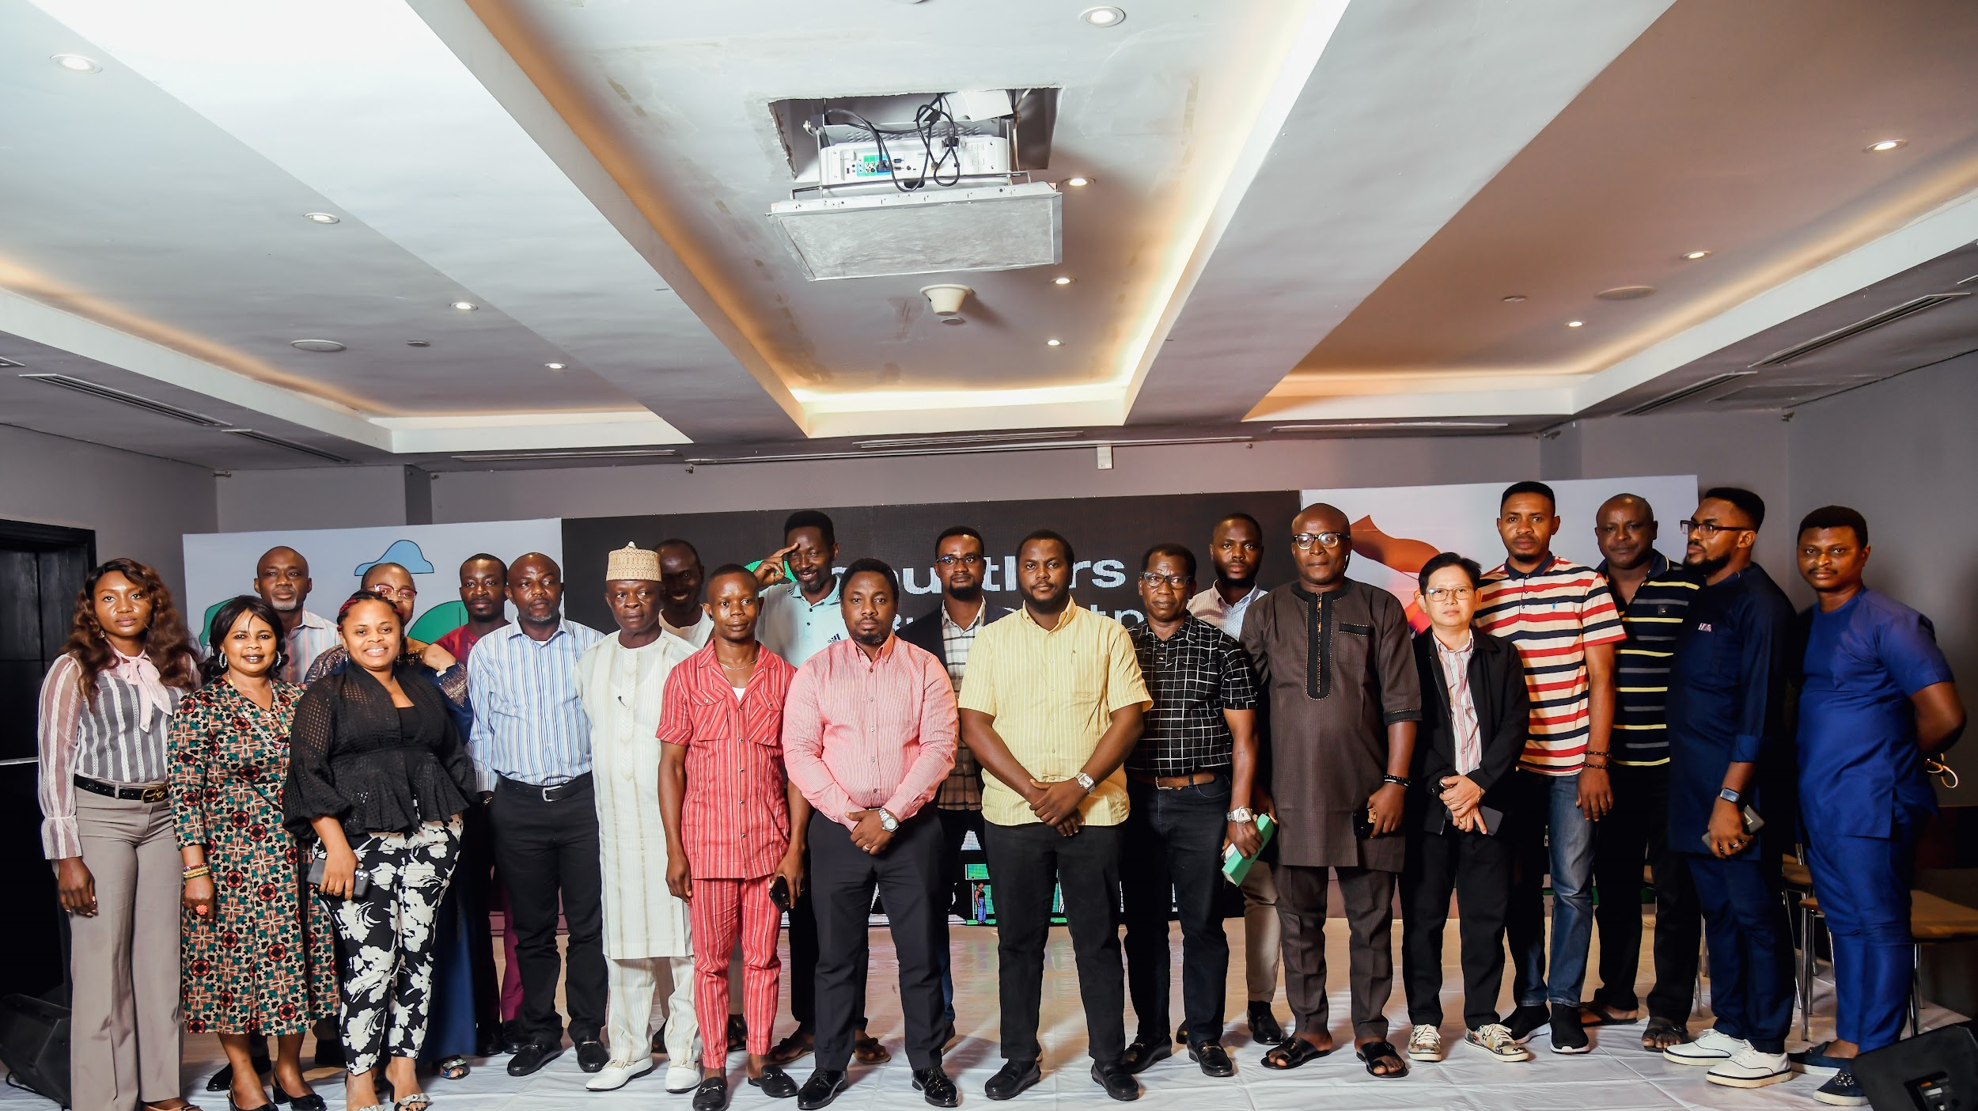
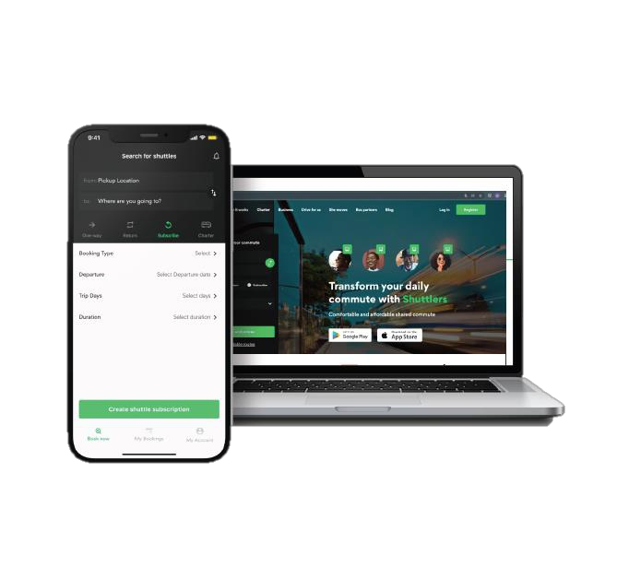
Unlocking More Opportunities with Shuttlers

Slide 2
Shuttlers provides tech-enabled mass transit solutions to individuals and companies.
Shuttlers | The Smart Way To Move

Slide 3
Market leader
We are the leading tech-enabled scheduled mass transit solution in Nigeria.
Shuttlers | The Smart Way To Move

Slide 4
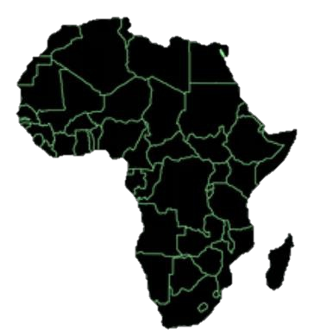
We have paid over N2.8 Billion
to bus partners over the years.
Guaranteed revenue is not just a possibility but a promise.
Shuttlers | The Smart Way To Move

Slide 5
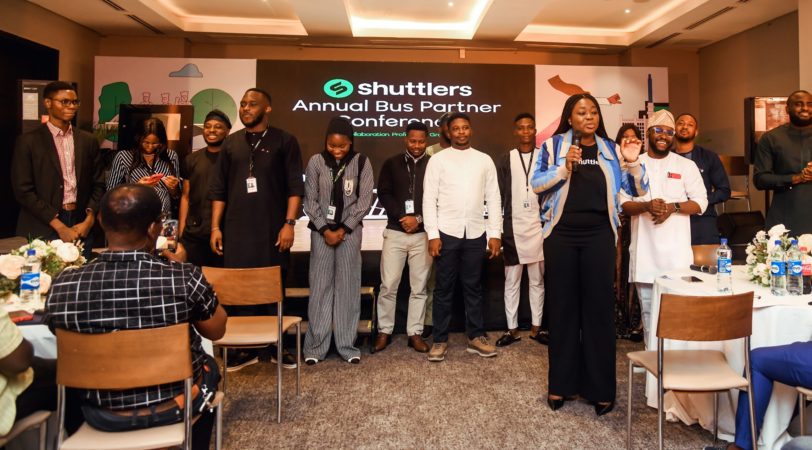
Our Value to You

Slide 6
Guarantee Uptime for Your Assets
Our primary commitments to our vehicle partners is ensuring the optimal utilization of your assets
Shuttlers | The Smart Way To Move

Slide 7
Guaranteed Revenue
Our primary commitments to our vehicle partners is ensuring the optimal utilization of your assets
Shuttlers | The Smart Way To Move

Slide 8
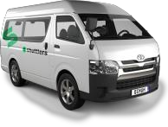
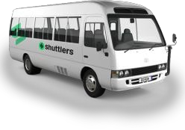
We Help You Secure Financing to Grow Your Fleet
Your growth is not a mere goal; it's a shared achievement
Shuttlers | The Smart Way To Move

Slide 9
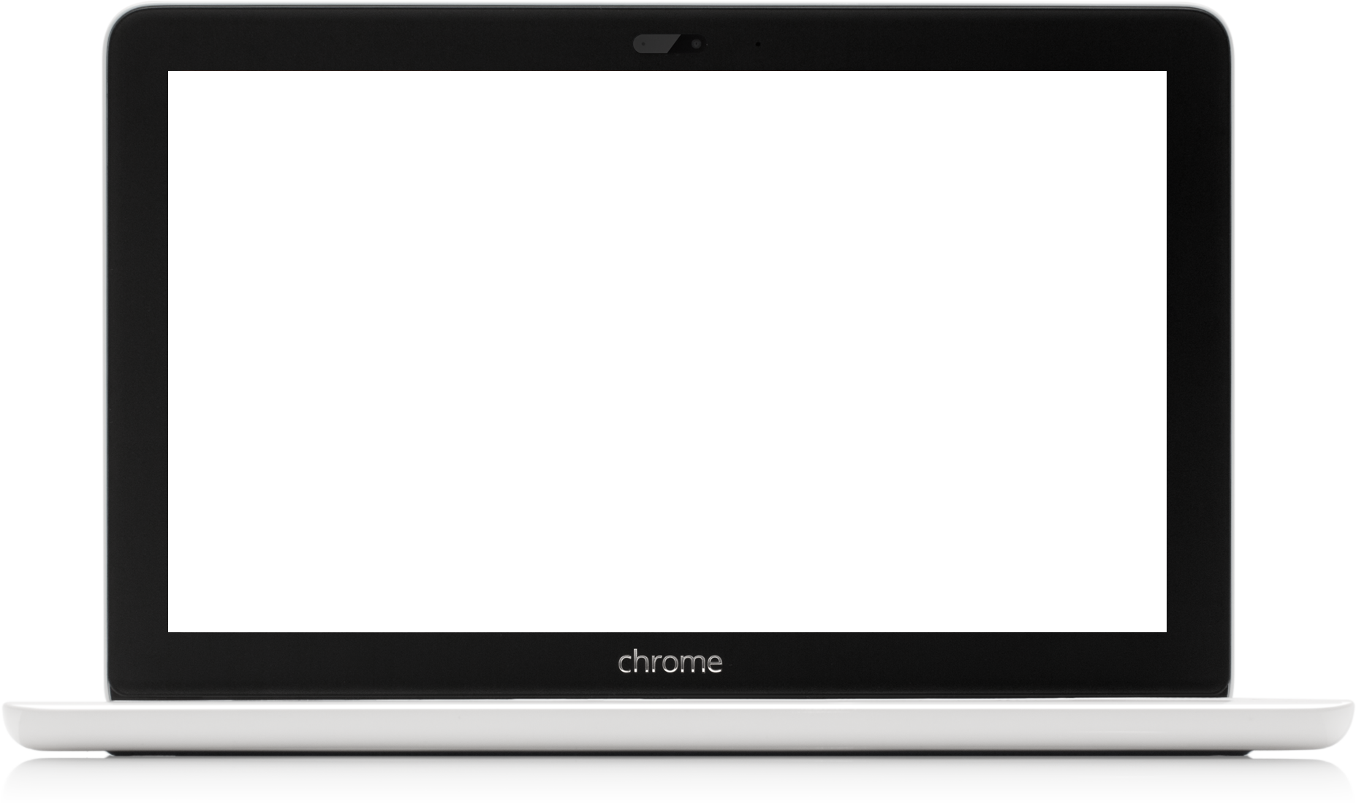
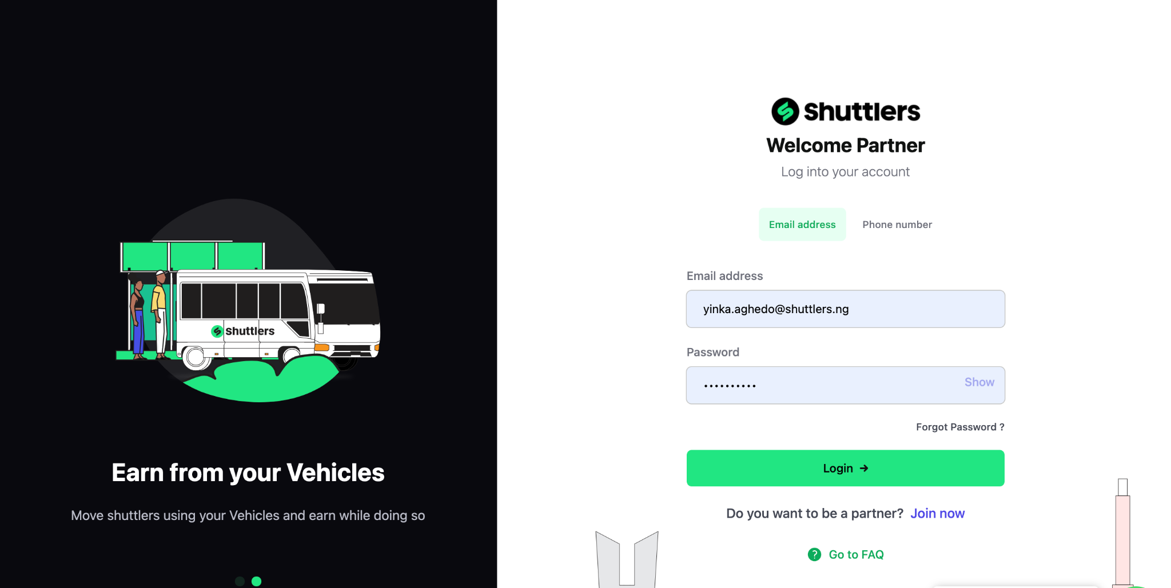
Technology that gives you control of your earnings and operations

Slide 10
The opportunity today

Slide 11
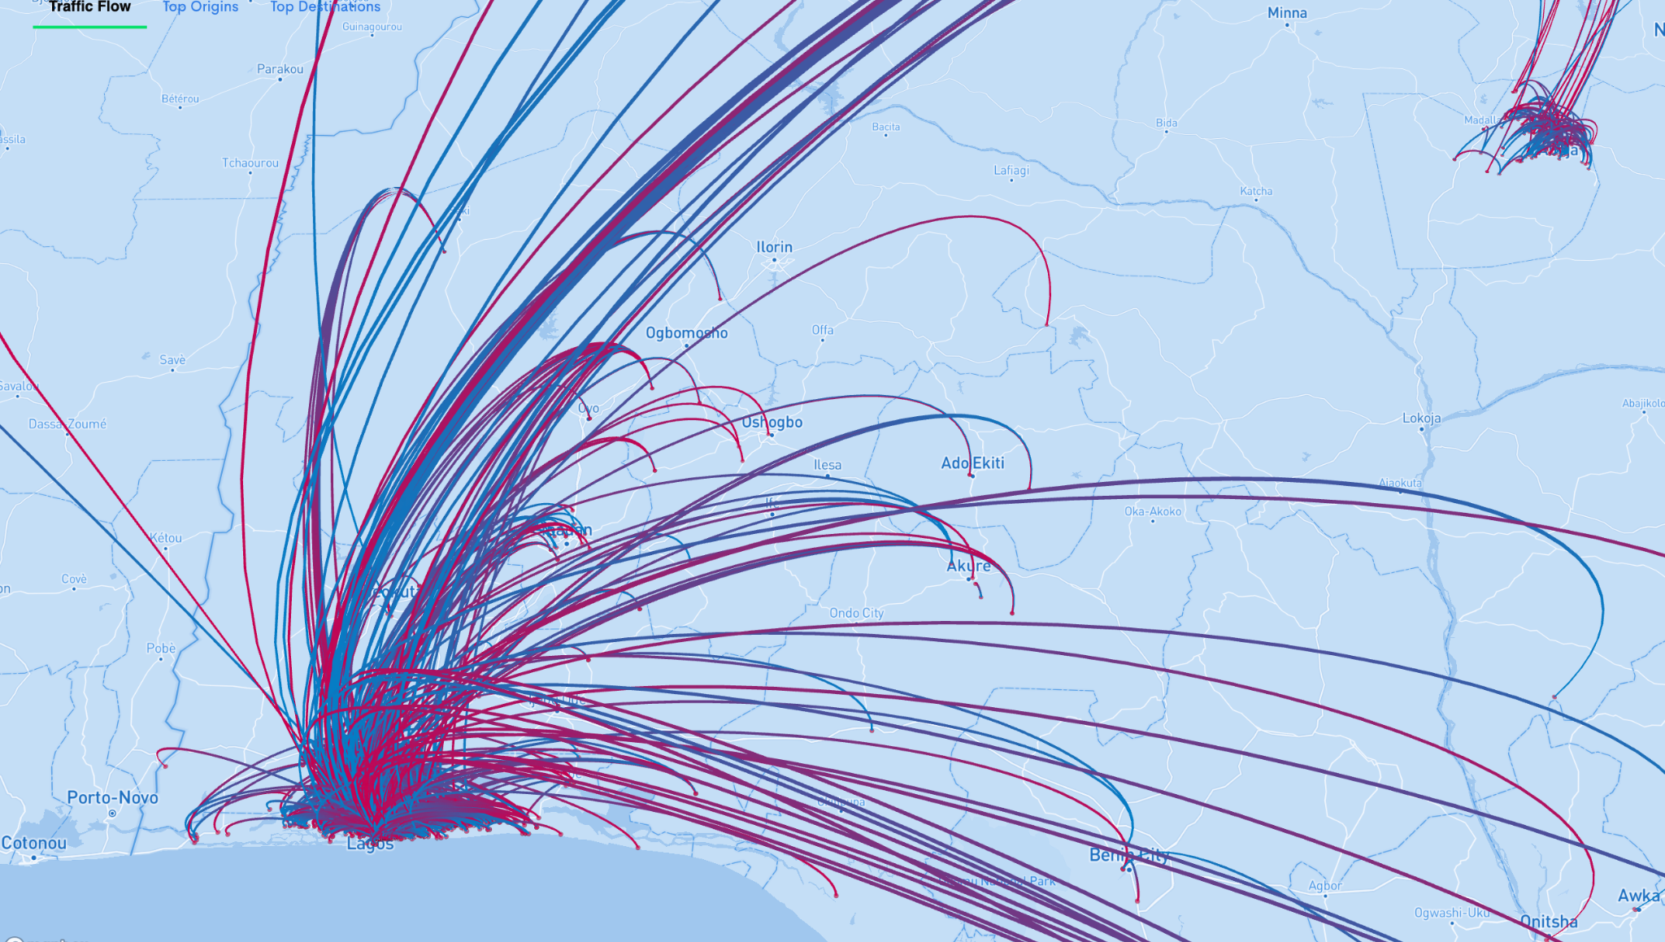
Our customers have requested for the creation of over 1,000 routes within and outside Lagos
2030
2022
251
routes
273
buses
Every dot represents a location on the map and the level of intensity of the request search is based on the number of route search per customer
We have expanded from 30 routes in 2021 to over 251 routes today in Lagos
Shuttlers | The Smart Way To Move

Slide 12
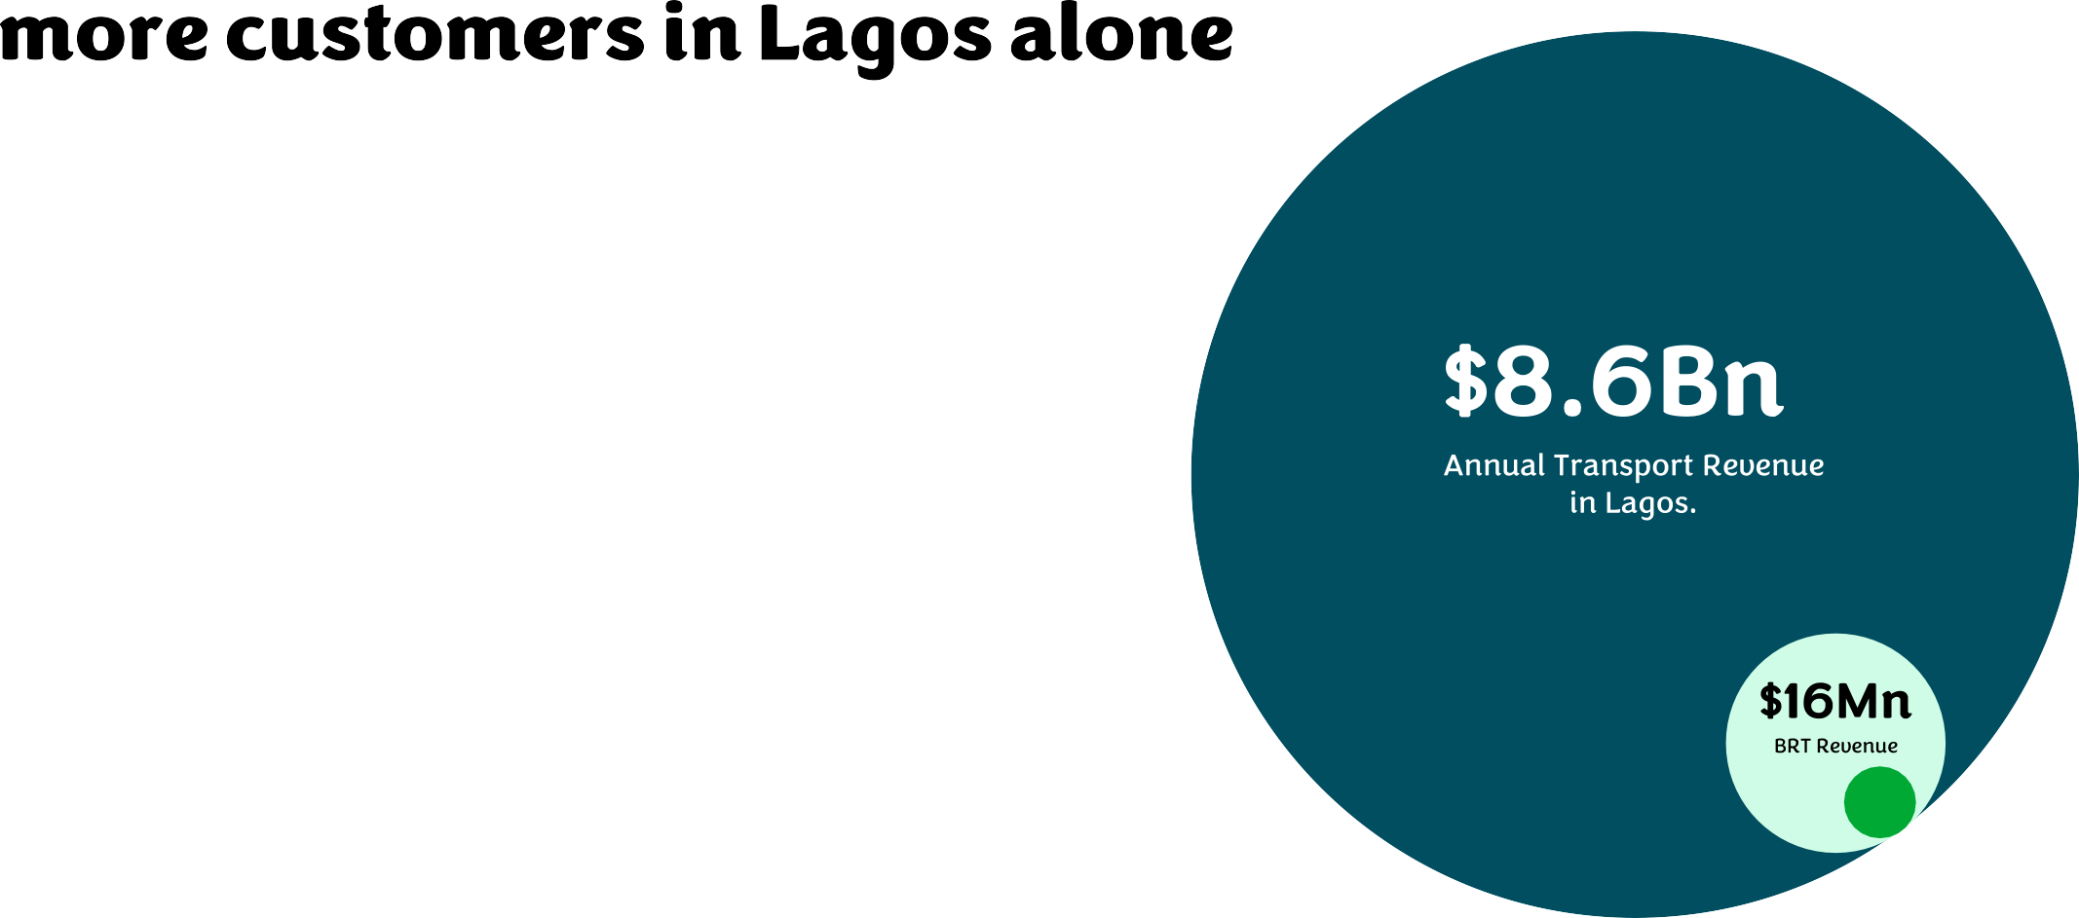
Shuttlers | The Smart Way To Move

Slide 13
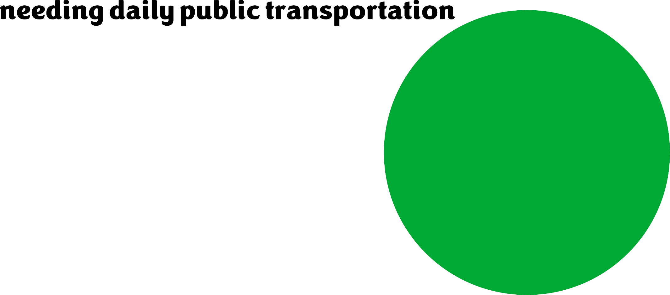
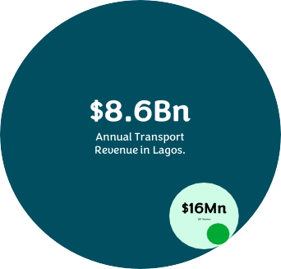
Shuttlers | The Smart Way To Move

Slide 14
Largest mobility platform in Africa
Local leadership, global scale
25
Cities,
in 11 countries
$100M
In Annual
Recurring Revenue
~40%
Of Market share in cities
we operate in

Slide 16
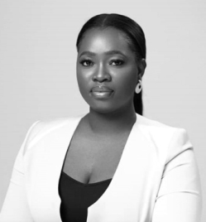
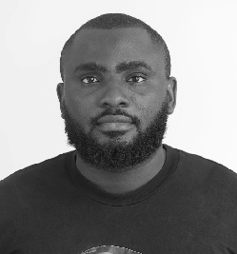
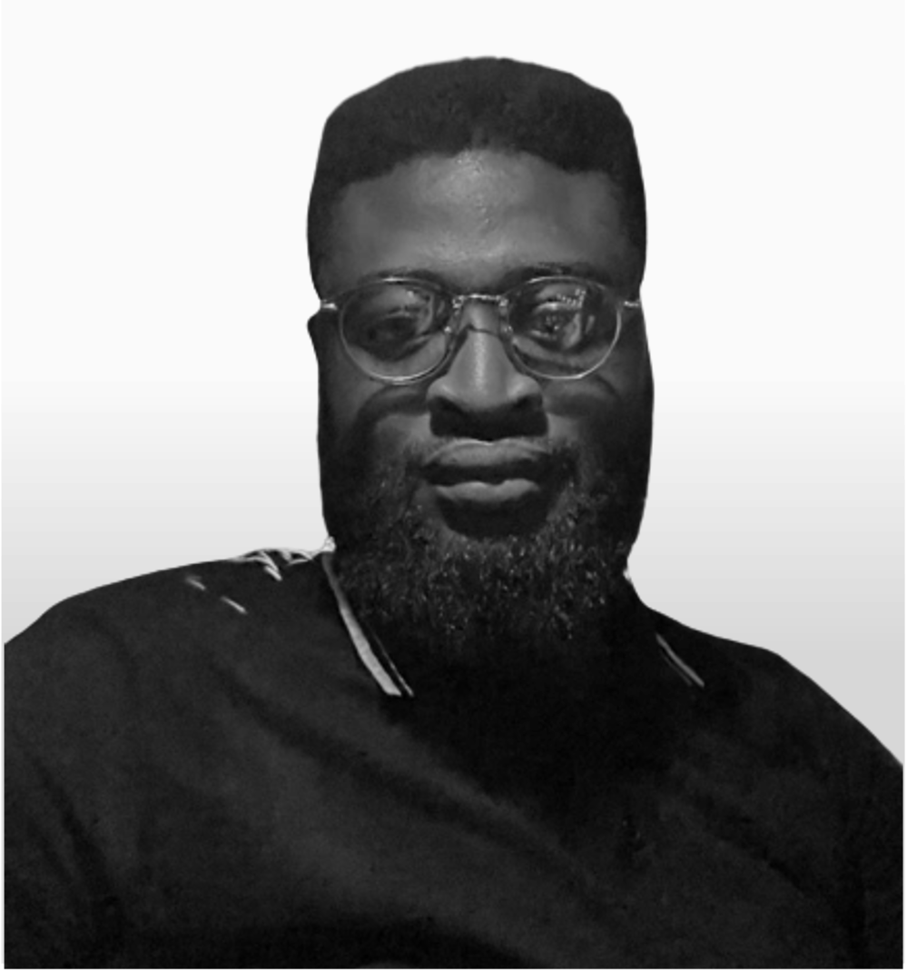
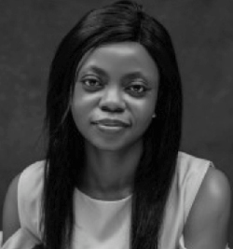
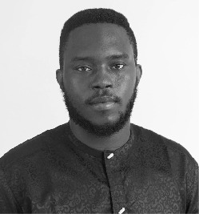
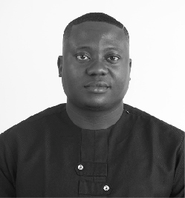
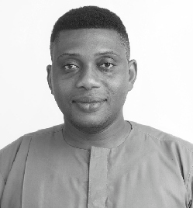
Damilola Olokesusi
Akachukwu Okafor
Chief Technology Oﬃcer
Paul Chukwuka
Head of Finance
Aderonke Olubowale
Head of Operations
Cofounder, CEO
B.Sc Chemical Engineering Experience from Engineering Investment Banking and Marketing Forbes30under30 2019
B.Sc Electronics and Computer Engineering
9 years Softwaíe Engineering experience from Schoolable (Yc backed), Payed and TechAdvance.
B.Sc Appliedl Accounting
8 years Accounting experience from FCMB Capital Market and Innovectives Digital Experience Group
B.Sc Political Science
5 years Opeíations management experience fíom Maíula Ventures and Max.ng
Ijeoma Anunibe
Head of People
Yinka Aghedo
Ebuka Obijiaku
Head of partnerships.
Babatunde Awe
Head of Customer Experience
Head of Marketing
M.Sc Economics
Experience from AgroMall, Tenaris, Reckitt and Access Bank
M.Sc Information Technology 10 years Marketing experience
from Kingmakers and Finchglow
BSc Industrial Relations and Personnel Management.
5 years Operations experience fíom Uber and Kobo360
B.Ed Computer Education
9 years experience championing Customer Experience from Zedvance, UBER, and Konga.
Shuttlers | The Smart Way To Move

Slide 17
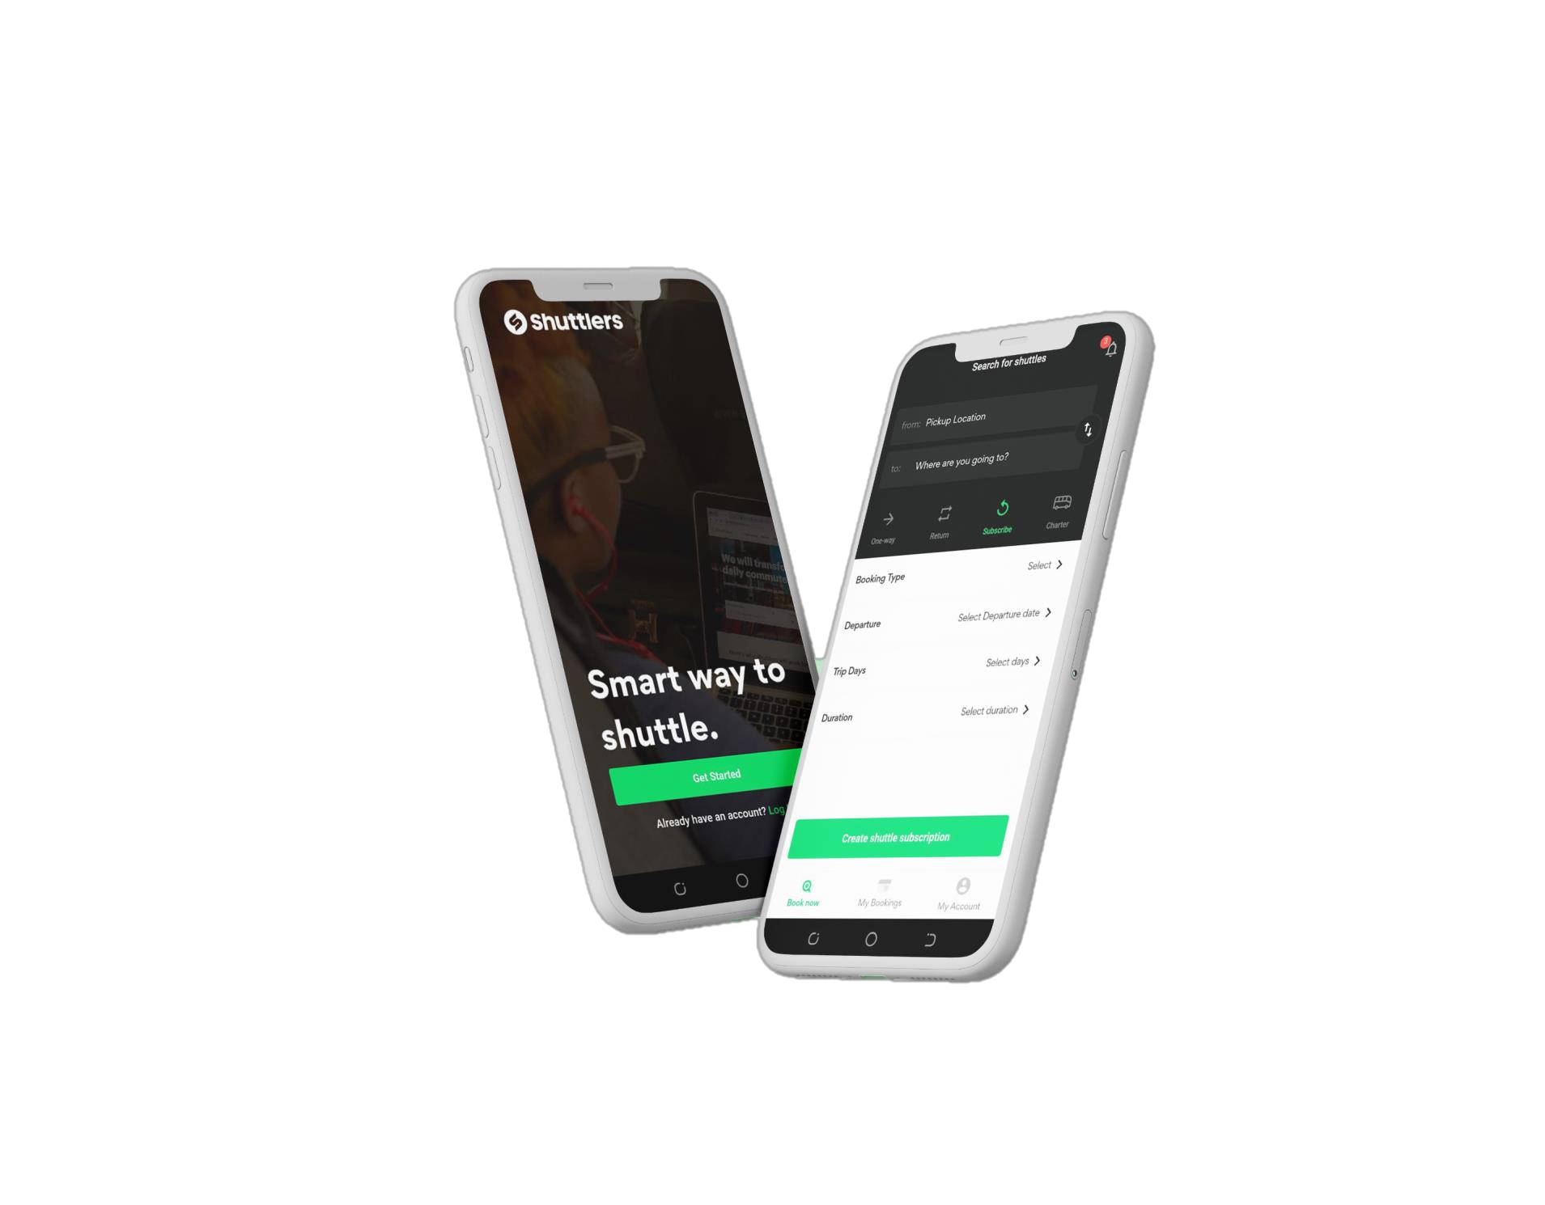
Partner with us to change the way people move globally!

