Slide 1
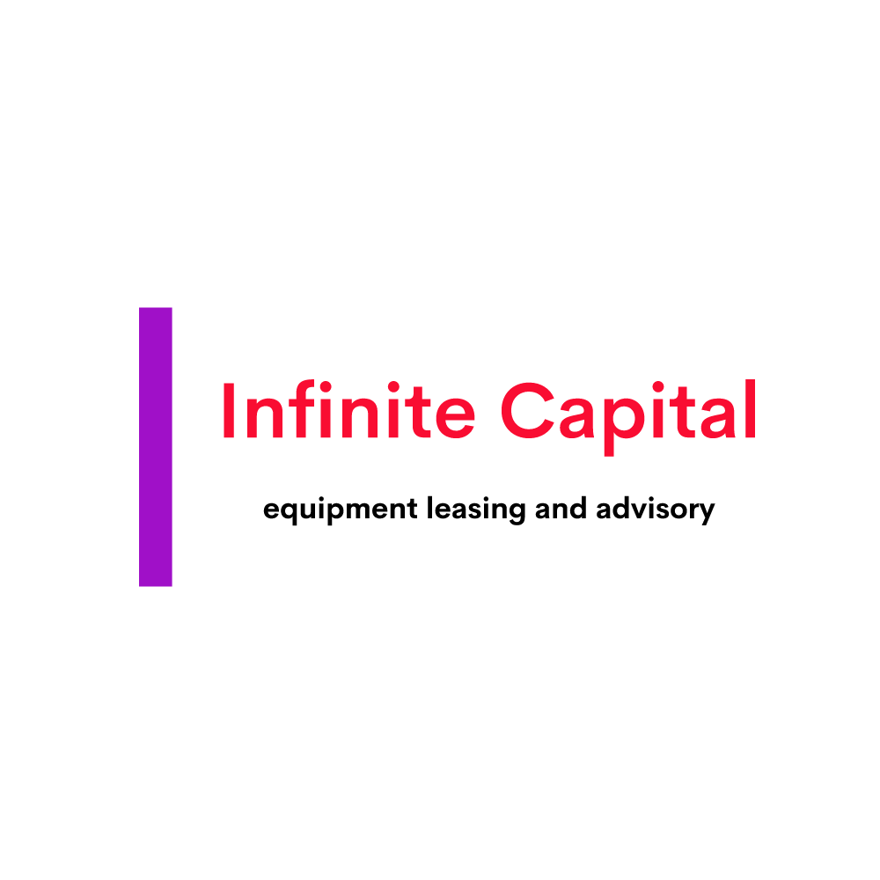
Evaluating the Impact of Equipment Leasing on Economic Development: Key Drivers and Militating Factors
Magan Jugurnauth
Infinite Capital, Canada
Leasing Advisory
Equipment Leasing Association of Nigeria, November 16, 2021

Slide 2
Brief Introduction-Magan Jugurnauth
Founder and CEO of Infinite Capital, a boutique Leasing Advisory Firm operating out of Toronto, Canada
35+ years of Banking cum Leasing expertise, within Mauritius, Sub-Saharan Africa and Canada
Carried out leasing assignments in a dozen Sub-Saharan African countries
Intermittent contributor to World Leasing Yearbook since 2009

Slide 3
Table of contents
Global and Regional Significance of Leasing
Leasing Penetration
Leasing and Economic Development
Leasing Ecosystem-Key Drivers of Growth

Slide 4
Global significance of leasing
All data sources courtesy of several World Leasing Yearbooks

Slide 5
Regional significance of leasing

Slide 6
Significance of leasing to Africa and South America

Slide 7
Leasing Penetration-Mature Markets

Slide 8
Leasing penetration-Developing Markets

Slide 9
Leasing and Economic Development
Leasing
Consumption
Government Expenditure (military, police, emergency, firefighting, waste collection, medical services
Public (infrastructure) and Private Sector Investment (GDFCF)
International trade (x-m)
Direct impact:
Jobs creation
Taxation Income
Indirect impact:
Indirect jobs
Multiplier effect

Slide 10
Leasing Ecosystem-Key Drivers of Growth
Lessee (Awareness and Product Knowledge)
Supplier (Reliance on Leasing)
Lessor (Rivalry can competition)
Public Policy and Vision
Market Infrastructure
Economic environment
Innovation and Technological Change
Funding (Types, availability and cost)
Industry Association
LEGAL ACCOUNTING REGULATORY TAXATION PILLARS

Slide 11
Conclusion
Leasing has direct positive correlation with investment, GDP and value creation
Leasing is not only the “product of best fit” for SMEs but for large companies, as well; comes with jobs creation, more consumer demand, multiplier effect.
Government can finance part of its CAPEX through operating leases
Countries with strong local/internal markets should pursue import substitution strategies though leasing, improve competitiveness and then envisage to move into exports led growth.

Slide 12
Thank you
Questions and Answers
Contact Details:
Magan Jugurnauth
Email: magan@infinite-capital.com
Tel: +1647 232 8326

