Slide 1
2021 FEDERAL AND STATE GOVERNMENTS ECONOMIC AGENDA: IMPACT AND OPPORTUNITY FOR LEASING+
BY
AKPAN H. EKPO++
+Virtual presentation at the Equipment Leasing Association of Nigeria (ELAN) Business Forum, 11th February,2021.
++Professor of Economics and Public Policy, University of Uyo and Chairman, Foundation for Economic Research and Training (FERT), Lagos.

Slide 2
Outline
Introduction
Concept of Leasing
State of the Nigerian Economy and Outlook for 2021
Overview of the Nigerian Leasing Industry
Empirics of the Leasing sub-sector in Nigeria
2021 Economic Agenda and Opportunities in the Leasing Industry
Challenges
Conclusion

Slide 3
1. Introduction
Given the availability of huge natural and human resources, Nigeria has the potential to becoming a leader in the global economy. However, this potential has been unattainable due to various economic challenges faced by the country over the years.
With a shift of the Nigerian economy from being an agrarian system in the 1960s to one which is oil-dependent, the country has been wallowing in the shackles of underdevelopment and its accompanying consequences.
Economic challenges facing the Nigerian economy include high rates of unemployment, soaring poverty, rising inflation rate, increasing debt burden, epileptic power supply, among others.
This has adversely affected virtually all sectors of the economy. In fact, the misery index for the country keeps rising over the years (Ekpo, 2020).
An emerging sector which has been in the forefront of resuscitating the Nigerian economy is the leasing industry whose activities span across several sectors in the country.
Through the years, this sub-sector has been growing steadily and contributing its quota to national development. In spite of several challenges, this industry has been durable and creative and has always been in the fore front of equipment acquisition and management.

Slide 4
With the recent ravaging Covid-19 pandemic, the immediate and medium-term future of the Nigerian leasing industry is unpredictable. As various states in Nigeria initiated the stay-at-home mandates, activities on construction projects were halted to curtail the spread of the disease.
This has severally affected the activities of the leasing industry, with its key players relatively rendered redundant. Even with the reopening of the economy, the recovery process has been painfully slow, though the industry appears to be recovering. As a counterfactual, the pandemic opens opportunities for the leasing sub-sector,
The actualization of the leasing industry’s objectives is attainable given that Nigeria requires massive infrastructural development in terms of power, roads, dams, national parks, construction of canals and channels, as well as drainages.
In recent times, the focus has been on rehabilitation of existing roads and railway construction. Several states in the federation are fully involved in construction of infrastructural facilities which requires the use of heavy equipment for bush clearing, levelling, excavating, construction works and sand filling.
Thus, the Nigeria leasing industry has the potential to be one of the biggest given the sheer size of the sectors which rely on its services.

Slide 5
Given the challenges encountered by the Nigerian leasing industry in 2020 due to the Covid-19 pandemic and other economic challenges, it becomes imperative to examine the opportunities of the sub-sector focusing on 2021 given prevailing and proposed government economic agenda.
It is expected that the inferences drawn from this paper will form the basis for economic appraisal in the leasing and allied sub-sectors of the Nigerian economy.

Slide 6
2. Concept of Leasing
Leasing is defined by the International Finance Corporation (2017, p.18) as
“… a medium-term financial instrument for the procurement of machinery, equipment, vehicles, and/or properties. Leasing provides financing of assets – equipment, vehicles – rather than direct capital. Leasing institutions (lessors) – banks, leasing companies, insurance companies, equipment producers or suppliers, and non-bank financial institutions–purchase the equipment, usually as selected by the lessee, providing the equipment for a set period of time to businesses. For the duration of the lease, the lessee makes periodic payments to the lessor according to an agreed upon payment schedule. At the end of the lease period, the equipment is either transferred to the ownership of the lessee/business, a secondary lease, returned to the lessor, or sold to a third party. Under financial leasing, the lessee typically acquires or retains the asset.”

Slide 7
Equipment leasing is a distinct form of financing in which an equipment is rented rather than purchased. Usually, these equipment are expensive (vehicles, machinery, high-processor computers; etc) and are highly essential for business operations.
Leasing deals combine several advantages of renting and buying. One feature of leasing is that immediately a contract deal is signed, the lessor “owned” the equipment.
This usually covers a specified period contained in the deal, after which the equipment is either returned, bought or the lease renewed.
Additional fees may be incurred in the lease deal. These include maintenance, insurance, repairs and other operational costs.
Leasing takes two forms; capital lease and operating lease. In the case of the former, the lessee is treated as the owner of the equipment during the lease period.
That means that during this period, the lessee covers the cost of taxes, maintenance, insurance and other operational costs. The operation and maintenance is wholly financed by the lessee.
The reverse is the case of operating lease. In this lease deal, the lessor finances the maintenance and other operating costs of the equipment (insurances, taxes, etc). These two forms of leasing have pros and cons which must be considered before a deal is struck by the lessee and the lessor (Kendell, 2016).

Slide 8
3. State of the Nigerian Economy and Outlook for 2021

Slide 9
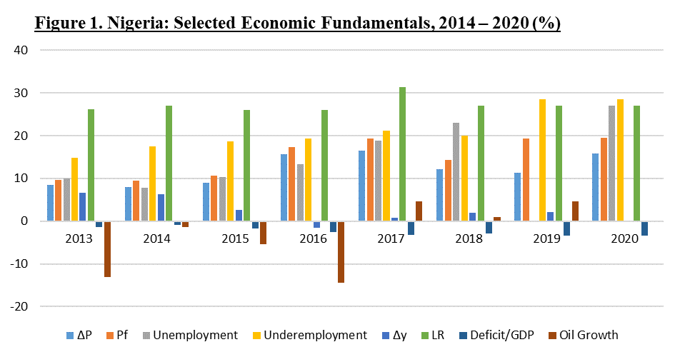

Slide 10
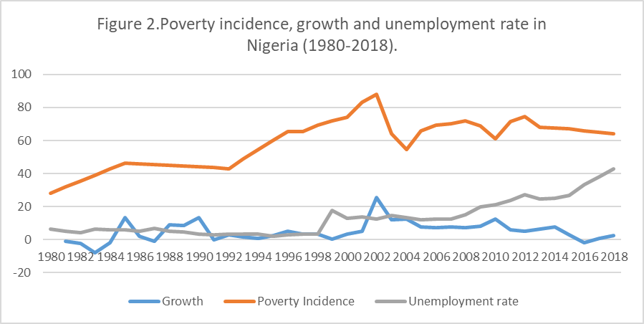

Slide 12
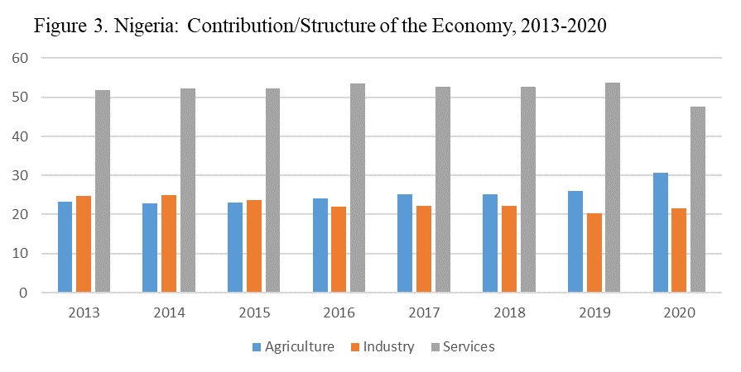

Slide 13
3.1 Overview of the Leasing Industry
The Nigerian leasing industry has evolved over the years. It has grown far beyond simple finance lease to more advanced operating lease through adopted innovative processes. There has also been advances in products offered as well as maturity schedule patterns.
The resiliency of this sector has influenced economic performance. Despite the economic challenges which have affected the leasing industry, leasing firms have thrived through the years.
For instance, we observed a steady growth pattern in leasing volume in Nigeria, growing from 654.83 million in 1990 to 19.65 billion in 2000 (See Table 3 below). In recent years, the industry generated N1.1 trillion, N1.26 trillion, N1.44 trillion, N1.68 trillion and N1.91 trillion in 2015, 2016, 2017, 2018 and 2019, respectively.
The year-to-year growth of the industry is shown in Figure 5. The figure clearly shows that the Nigerian leasing industry has achieved consistent double digit growth rate over the years except in 1993, 1994 and 1996 where negative growth rates were recorded.
This was due to the negative impact of the structural adjustment programme coupled with the inconsistent and ad hoc policies of government. in addition, rising rate of inflation and the exchange rate affected the leasing sub-sector.

Slide 14
It should be noted that the industry experienced over a 100 percent year-to-year growth in 1992 (159.5%) and 1995 (251.5%).
This is possibly caused by spike in the utilization of equipment in industries in the 1990s. Increased awareness of leasing options, increased players in the industry, enhanced investment as well as expanded market contributed to the success of the industry (ELAN, 2019).

Slide 15
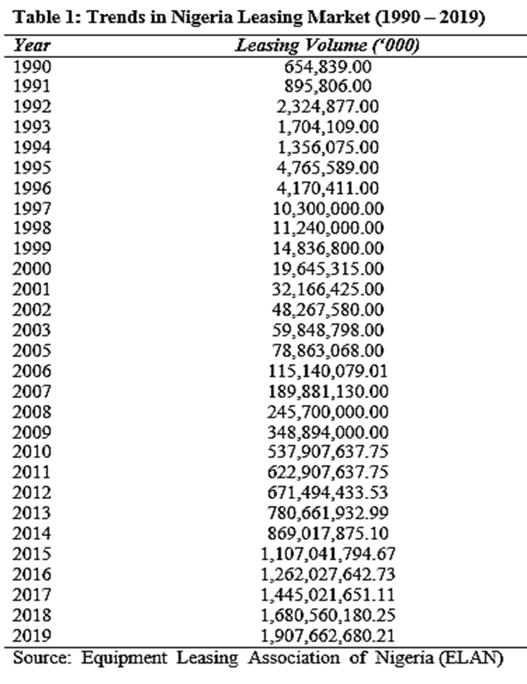

Slide 16
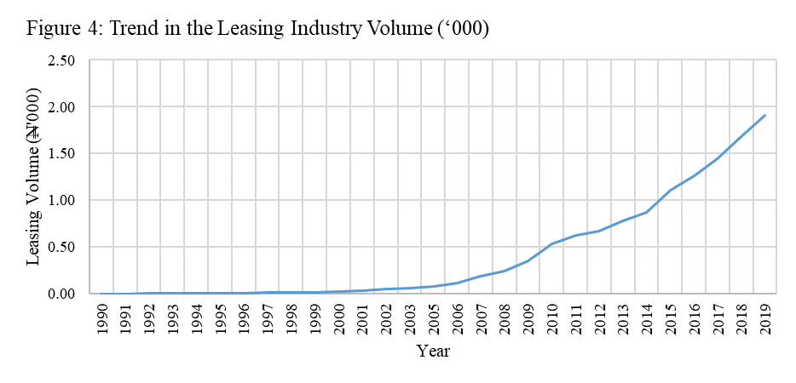

Slide 17
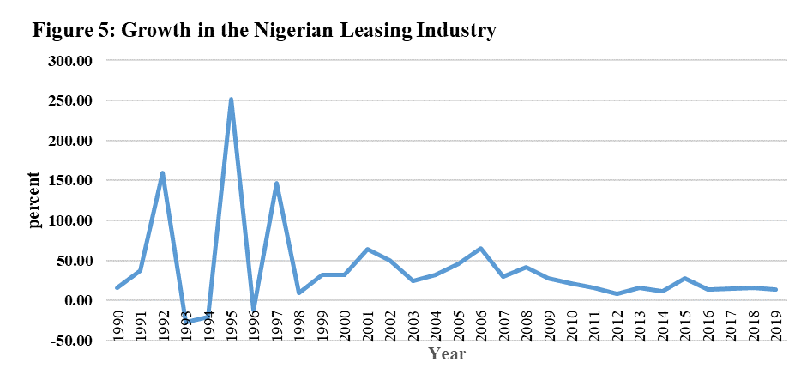

Slide 18
4. Empirics of the Leasing Sub-sector in Nigeria

Slide 19
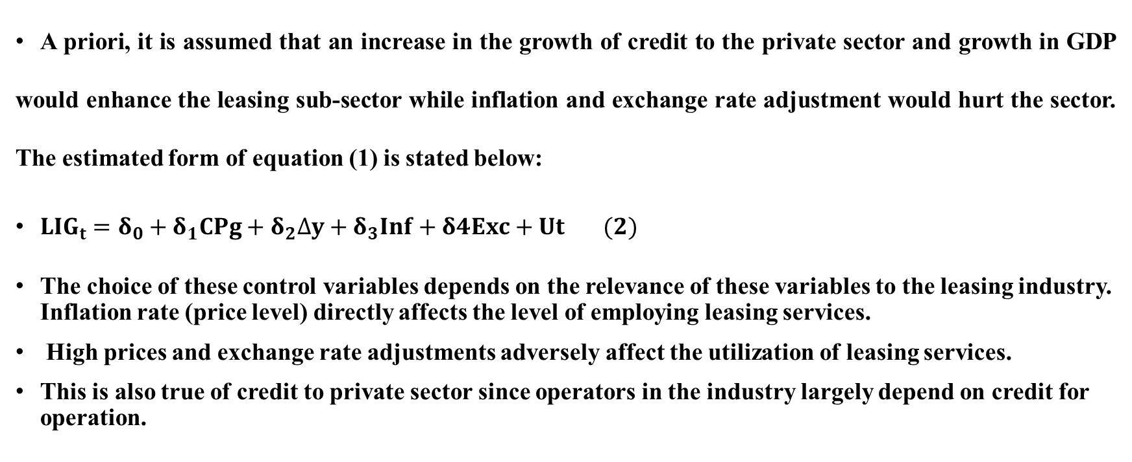
A priori, it is assumed that an increase in the growth of credit to the private sector and growth in GDP would enhance the leasing sub-sector while inflation and exchange rate adjustment would hurt the sector. The estimated form of equation (1) is stated below:
${LIG}_{t}=δ_{0}+δ_{1}CPg+δ_{2}∆y+δ_{3}Inf+δ4Exc+Ut (2)$
The choice of these control variables depends on the relevance of these variables to the leasing industry. Inflation rate (price level) directly affects the level of employing leasing services.
High prices and exchange rate adjustments adversely affect the utilization of leasing services.
This is also true of credit to private sector since operators in the industry largely depend on credit for operation.

Slide 20
From the results credit to the private sector negatively affects the performance of the leasing industry in Nigeria contrary to expectation although it is not statistically significant.
Devaluation of the exchange rate has an adverse effect on the leasing industry as expected. The growth in GDP is positively related to the leasing industry and it is statistically significant.
Explicitly, a 1 increase in the growth of GDP increases the performance of the Nigerian leasing industry by over 3.5 percent. Inflation negatively affects the performance of the industry as expected.
The R-Squared value of 0.72 showed that over 70% variation in the performance of leasing industry in Nigeria is explained by the explanatory variables in the model.
The model is devoid of autocorrelation as can be seen in the value of the Durbin Watson statistic (2.059).

Slide 21
The negative speed-of-adjustment coefficient [ECM(-1)] measures how strongly the dependent variable reacts to a deviation from the equilibrium relationship in one period or, in other words, how quickly such an equilibrium distortion is corrected.
In the case of our model, the error-correction term implies that about 55 percent of disequilibrium in the leasing industry is corrected within one period.
The findings of the above model have economic implications for the Nigerian leasing industry. It showed that if the Nigerian economy is growing positively, the leasing industry will be stimulated.
It also showed that the industry has a strong potential to withstand challenges and attain equilibrium within a short time.

Slide 22
2021 Agenda in Nigeria And Opportunities
Description | 2019 Actual | 2020 Budget | 2021 | 2022 | 2023
Oil Price Benchmark (US $/b) | 67.2 | 28.0 | 40.0 | 40.0 | 40.0
Oil Production (mbpd) | 1.96 | 1.80 | 1.86 | 2.09 | 2.38
Exchange rate (N/S) | 305.0 | 360.0 | 360.0 | 360.0 | 360.0
Inflation (%) | 11.98 | 14.15 | 11.95 | 10.94 | 11.02
Non-Oil GDP (N’bn) | 131,810.1 | 131,155.5 | 132,592.2 | 134,154.5 | 139,304.9
Oil GDP (N’bn) | 12,400.4 | 8,691.9 | 10,102.2 | 12,640.0 | 12,159.5
Nominal GDP (N’bn) | 144,210.5 | 139,517.5 | 142,192.1 | 146,072.8 | 150,497.7
GDP Growth Rate (%) | 2.27 | (4.20) | 3.00 | 4.68 | 3.86
Nominal Consumption (N’bn) | 119,281.6 | 117,913.7 | 118,887.3 | 120,835.4 | 125,157.3

Slide 23
It is projected that with the Nigerian economy slowly recovering from the effects of the Covid-19 pandemic which resulted in lockdown of economic activities for a period, increased demand for oil globally will improve oil prices in 2021 and will stimulate oil-GDP to grow at nearly 8%.
This is an improvement over the sharp drop in oil prices orchestrated by the pandemic in 2020. The improvement in oil-GDP has a dire effect on non-oil GDP growth in 2021.
It is projected that on a year-on-year basis, the non-oil sector growth will grow at 2.43% in 2021. As a result, 2021 real GDP growth was projected to be 3.0%, while nominal GDP is expected to increase to N142,192.1 billion in 2021 from N139,517 billion in 2020.

Slide 24
Consumption expenditure is projected to be N118,887.3 billion in 2021 with an accompanying inflation rate of 11.95%, a figure slightly above single digit. Aggregate revenue and expenditure were projected to be N6.15 trillion and N12.66 trillion, respectively; and a budget deficit which is projected to be N5.16 trillion in 2021 (Budget Office of the Federation, 2020).
From available economic data, there is a large market for the Nigerian leasing industry. Apart from the above macroeconomic projections, the federal government in collaboration with the states has established a N500 billion COVID-19 Crisis Intervention Fund.
The following are some of the intended expenditure items of the COVID-19 Crisis Intervention Fund which holds opportunities for the leasing industry:

Slide 25
-N36 billion to support State Governments
-N12.43 billion for Energy for All: Mass Rural Electrification/Solar Power Strategy Programme
-N60.0 billion for Maintenance of Roads
-N52.0 billion Public Works Programme
=N126 billion for upgrading healthcare, infrastructural facilities and operations across Federal Medical Centres, Teaching Hospitals and
others’
-N6.0 billion for Artisanal and Small-Scale Miners.
From the above it can be stated that the leasing industry can leverage on both the federal and state governments’ economic agenda in areas such as agriculture, construction, mining, technology and healthcare sectors.

Slide 26
5.1 Opportunities
Construction
Agriculture
Mining
Education
Technology
Health

Slide 27
5.2 Challenges
Unstable Macroeconomic environment
Lack of access to finance
Lack of legislative framework
Lower industrial penetration
Security Issues
Evolving digital technologies

Slide 28
6. Conclusion
The opportunities in the leasing industry are not limited to the federal government alone as various state governments are designing and adopting programmes and projects which will require the utilization of leased equipment. The empirical results indicate that the rate of inflation, the exchange rate and the growth of access to credit are negatively related to the growth of the leasing sub-sector. On the other hand, increased growth of the economy is beneficial to the leasing sub-sector.
It is crystal clear that the Nigerian leasing industry has a promising future given the macroeconomic environment. Federal and state governments’ economic agenda to better the lot of the citizenry will provide a large market to explore. It is thus imperative for the key players in the industry to utilize these opportunities through market research and capacity building.

Slide 29
There is need for the industry to carry out feasibility studies to understand the needs of potential customers, changes in business operations and legal obligations.
Diversification in products should be encouraged to provide potential customers with a wide range of leasing options. This should also be accompanied by sound corporate governance to create appropriate awareness and encourage patronage.
The federal and state governments also have roles to play in this regard. The government should provide an enabling environment to support the industry. One way of achieving this is through providing viable financing options for the operators in the industry.
The tax structure can be relaxed for such operators to enhance their operations. By creating a safe environment in terms of security, equipment will be safe in site and operators will avoid unnecessary losses caused by security issues.
Owing to its ability to contribute to economic growth, the Nigerian leasing industry should be given full attention and support in its operations. The 2021 federal and state governments’ economic agenda provides a basis for such activity.
However, federal and state agencies should put in place polices to enable the leasing sub-sector to have easy access to credit.

Slide 30
THANK YOU FOR YOUR ATTENTION
ahekpo@gmail.com
www.akpanhekpo.com

