Slide 1
EQUIPMENT LEASING ASSOCIATION OF NIGERIA (ELAN)
WINNING THE DEAL IN A VOLATILE AND COMPETITIVE ENVIRONMENT:
KEY CONSIDERATIONS AND STRATEGIES FOR SUCCESS
1

Slide 2
PRESENTED BY
CHIEF IKENNA OKAFOR FCA
MANAGING DIRECTOR/CEO
KEVES GLOBAL LEASING LIMITED
PORT HARCOURT
2

Slide 3
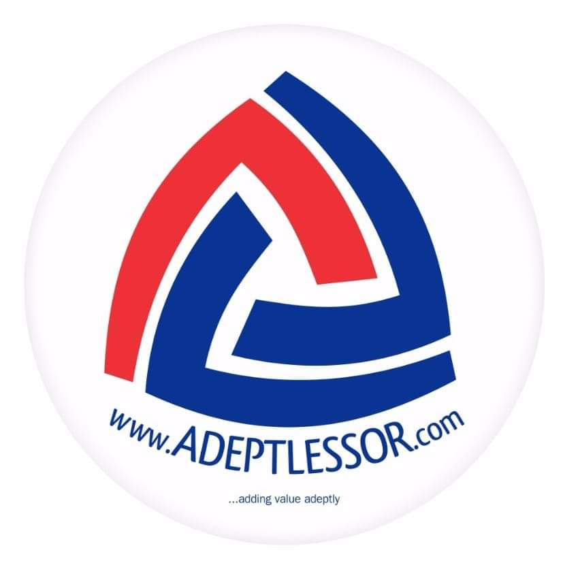
18TH NATIONAL LEASE CONFERENCE: OUR PARTNERS

Slide 4
INTRODUCTION
In order to continuously put your company in business, consider the two key words,
Volatile – Liable to change rapidly and unpredictably, especially for the worse.
Competitive – Performs better than others in similar business ideally in a sustainable way rather than over the short term.
3

Slide 5
Examples of Competitive advantages
Access to a franchise/OEM that are restricted from competition
Highly skilled labour
Unique geographic location
Access to new or proprietary technology
Ability to deliver services at the lowest cost
Brand image recognition that will aid in premium pricing
4

Slide 6
For Companies to survive in a volatile competitive environment it has to be;
Able to attract & retain quality staff
Have very good market intelligence & competitor information
Think outside the box on a continuous basis
Reward competitiveness
Have a good risk management system
Adequately insured
Have contingency plans
If you don’t plan for tomorrow, tomorrow overwhelms you
5

Slide 7
In today’s economy, business leaders are being called upon to answer the question:
What are the sustainable strategies designed to ensure that their business succeeds?
This question leads to another: What does “sustainability” mean?
–The ability to survive and grow over time.
Michael Useem and co-authors published the findings of opinions of 14 leading major companies ranging from Tyco to Travelers, Pepsi to Macys. In particular, they agreed that leaders “must confront and accept the present, while keeping faith in and working towards the future, no matter how dark the present is”.
6

Slide 8
Building off this understanding
The survival toolkit of strategies that will ensure organisations thrive for several decade includes:
Competitive Pricing
Modular and flexible pricing
Emerging market penetration – having the first mover advantage
Good customer service & flexibility
Huge cash outlay/access to cheaper funding
Highly trained & motivated work force
Security planning
Create niche market
Financial rewards aligned with results not just longevity
Fit for purpose facilities and equipment
Controlled back office costs
Assets clutching
7

Slide 9
Competitive pricing
Don’t price a product/service way above/below competition except you have a monopoly position i.e OEM, Franchise
Maintain a good accounting function to capture all costs
Monitor replacement costs of asset
Consider the terrain of service – island or swamp
8

Slide 10
Modular and flexible pricing
Customers should have choices and feel in control
Consider having low, medium and high price points for some products
Assets used in swamp environment should be priced higher than the one used on land
Asset less used should be priced lower than ones used more
9

Slide 11
Emerging Market Penetration
You must plan and be ready to get first mover advantage
Introduction of electric cars in array of lease products
Due to insecurity consider armoured vehicles & trucks
COVID 19 poses a challenge
You must innovate or perish
Business leaders must note that living for the short term put long term success at risk
Should predict and prepare for change on a continuous basis
10

Slide 12
Good Customer Service & Flexibility
This is the game changer
Should never have a one size fit all solution to clients
Should not charge same price to different clients except they have same costs
Be proactive in maintenance of assets/equipment
- Preventive and not Breakdown maintenance
11

Slide 13
Huge Cash Outlay/Access to Cheap Fund
Never continuously use overdraft to run business except on few occasions
Develop a strategic policy to fund operations and not a reactive one
Consider partnerships/ alliance relationship where possible
12

Slide 14
Highly Trained & Motivated Workforce
Time honoured factor of production must be nurtured & cherished by all CEO’s
Employ people who will tell you what to do
Expect results and not reports
Train, retrain and train workforce
Company values and policies must be lived by the business leaders
13

Slide 15
Security Planning
Now a factor of production that can mar any business
Must be incorporated in all business plans
Partner with host environment
Take CSR very seriously
- Don’t use turbine in a community without electricity without extending to them
14

Slide 16
Create Niche Market
You cannot be all things to all men
Identify the market segment you have competitive advantage and play there
Decide on segment descriptions and be close enough to them
Cater for your market & serve then in the way to reward your company
15

Slide 17
Financial Rewards aligned with Result
Deliver cult followership for employees by designing rewards based on results
Percentage of profit for jobs closed
Stock options
Overseas training/vacations
16

Slide 18
FIT for Purpose Facilities and Equipment
Should not be a museum of old equipment/assets
Prompt resolution to service delivery failure complaints
Ownership of good workshop or access to one
Continuous change of facilities/assets
17

Slide 19
Controlled back office Cost
This is a cost driver and the customer might not perceive their value
Leverage on technology to replace manual processes
Reduce unnecessary protocol
Stock essential materials
Decision making process should not be too lengthy
18

Slide 20
Asset Clutching
You do not need to own a high rise corporate office and use overdraft to finance cost of a vehicle
Tie down huge capital to acquire a vessel in anticipation of a contract when you can wet lease in the short run
Never buy non income yielding asset except its an essential asset
19

Slide 21
Past and Present considerations
Business Planning and Execution were a lot easier in the past. You can extrapolate and draw an analogy with relative certainty or measured degree of error,
In the present, uncertainties have become everyday occurrence and unpredictable e.g. COVID 19 changed the world order.
US elections have shown that rigging happen anywhere there is nothing is a taboo subject now
20

Slide 22
Future Business Behaviours
Seek, Listen and Implement advisories by experts and relevant agencies by reviewing Crisis Management Team (CMT) and business continuity plans
Continue to adjust operating levels to accommodate shifting threat conditions in our localities
Monitor recent happenings and provide updates. As a CEO, provide advisories to staff on how to improve personal and situational awareness
Keep your remote operations plan simple and flexible
21

Slide 23
THANK YOU
22

Slide 24
Questions & Answers
23

