Slide 1


NATIONAL LEASE
CONFERENCE 2017

Slide 2
Presentation of
PATRICK INIOVOSA
MD/CEO a Finance and Investment Company licensed by the Central Bank of Nigeria (CBN).
NATIONAL LEASE
CONFERENCE
2017

Slide 3
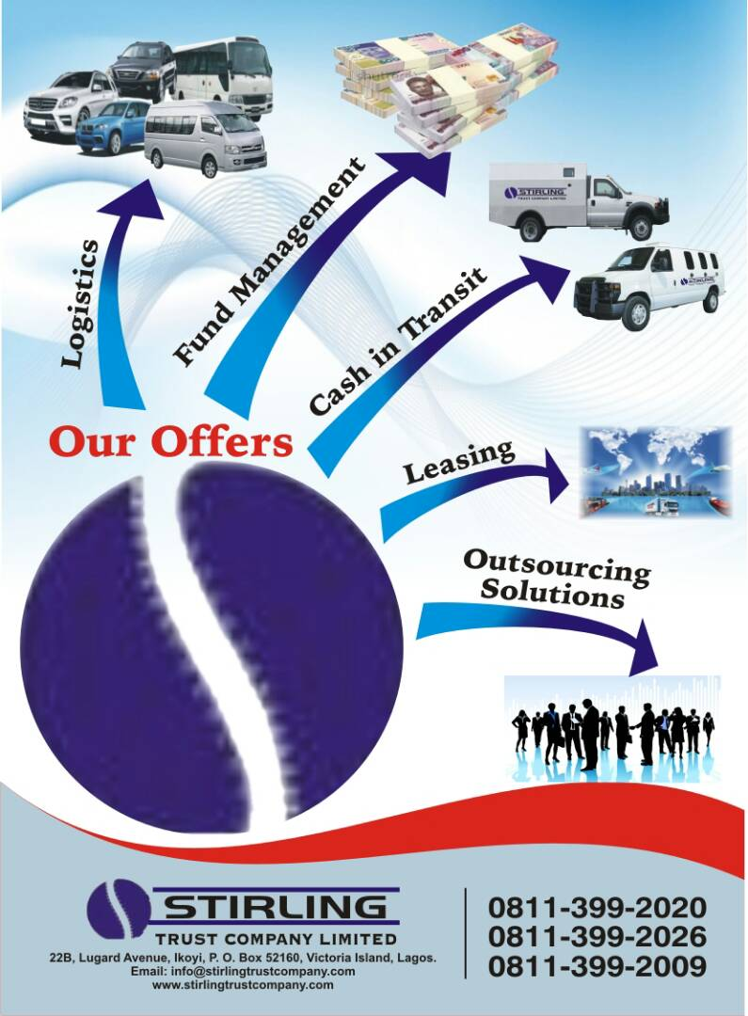
WHAT
WE
DO

Slide 4
TOPIC:
EXPLORING THE EMERGING OPPORTUNITIES IN THE LEASING INDUSTRY;
PRODUCT DEVELOPMENT
AND
SUCCESS FACTORS
NATIONAL LEASE
CONFERENCE
2017

Slide 5

Key points
NATIONAL LEASE
CONFERENCE
2017
Overview - Nigeria Economic Outlook
Emerging Opportunities
Leasing Business (Alternative and Imperatives)
Key Success Factors
Final Words

Slide 6

Overview - Nigeria’s Economic Outlook
NATIONAL LEASE
CONFERENCE
2017
NIGERIA, with approximately 184 million inhabitants, accounts for 47% of West Africa’s population, and has one of the largest populations of youth in the world.
With an abundance of natural resources, Nigeria—Africa’s biggest oil exporter—also has the largest natural gas reserves on the continent.

Slide 7
Overview - Nigeria’s Economic Outlook
NATIONAL LEASE
CONFERENCE
2017
LOOKING BEHIND-
Nigeria’s economy grew by only 2.7% in 2015, significantly below its growth of 6.3% in 2014. In 2016, it deteriorate further after recording negative growth in the first two consecutive quarters (-0.4% and -2.1% year-on-year in real terms, respectively). In the third quarter, GDP contracted by 2.2%, driven by a significant decline in the country’s oil output, shortages of power, fuel, and foreign exchange. Inflation doubled to 18.8% (projected) at the end of 2016, from its level of 9.6% at the end of 2015, mainly as a result of fuel and electricity price increases and the depreciation of the Nigerian naira during the year.
[Recession]

Slide 8
Overview - Nigeria’s Economic Outlook
NATIONAL LEASE
CONFERENCE
2017
LOOKING AHEAD
Nigeria’s economy is expected to grow by about 1% in 2017 and 2.5% in 2018, based on an expected increase in oil output, as well as the accelerated implementation of public and social investment projects by the Federal Government.
The recent lower growth rate of the Nigerian economy has resulted in a renewed focus on economic diversification, promoting growth in the private sector, and driving job growth.

Slide 9
The Leasing Industry
NATIONAL LEASE
CONFERENCE
2017
Global: Equipment Leasing is the most accessible financing alternative of today. (All-Africa – Sept. 2014).
It is estimated that global lease transactions amounted to over USD1.0Trillion annually.
In 2015, Lease volume stood at USD 1,005.30Trillion from first 50 Countries in leasing business. (See White Clark Group Global Leasing Report 2017).
Nigeria; In Nigeria, the sum of NGN1.26 Trillion represents the amount outstanding on equipment leases in year 2016 with about 80% coming from other sources than Banks and focused on MSMEs.
In the past 15 years, leasing has contributed over N7.38trillion to the development of the Nigerian economy. It remains therefore, a vital and central ingredient for growth and combating poverty.
(Equipment Leasing Association of Nigeria-ELAN 2016)

Slide 10
THE LEASING INDUSTRY
NATIONAL LEASE
CONFERENCE
2017
(ELAN 2016)
Table 2: Trends in Nigeria Leasing Market (2006 – 2016)
Year | Leasing Volume (‘000) | Growth (%)
2006 | 189,881,130.00 | 65
2007 | 245,700,000.00 | 29
2008 | 348,894,000.00 | 42
2009 | 445,265,650.00 | 28
2010 | 537,907,637.75 | 21
2011 | 622,907,637.75 | 16
2012 | 671,494,433.53 | 8
2013 | 780,661,932.99 | 16
2014 | 869,017,875.10 | 11
2015 | 1,107,041,794.67 | 27
2016 | 1,262,027, 642.73 | 14

Slide 11

THE LEASING OPTION
NATIONAL LEASE
CONFERENCE
2017
Why is leasing business growing?
Cash is tight
Start up is even harder for any business
Growth and Growing demand of flexible use of expensive items(equipment/property)
Leasing is the crucial and viable alternative for the Nigeria Business Growth & Recovery. Our National drive to diversify the economy and propel non-oil growth cannot be successful without a well articulated, inclusive and leveraging platform. LEASING provides this sole and viable option.

Slide 12

LEASING – THE OPPORTUNITIES
NATIONAL LEASE
CONFERENCE
2017
The Alternative: Leasing provides the viable alternative and lessors can take advantage of the opportunities abounding on Land, Sea and Air. In fact, Nigeria is toasted as the investment bride because of the unending opportunity. Few are highlighted below:
Equipment availability for Infrastructure Development
Large-scale farming equipment (Community of farmers can be availed access to the equipment).
Warehousing of products/farm produce (Silos, tank-farms etc)
Haulages. Nigeria is still road transportation dependent.
Mineral extraction equipment
And lots more

Slide 13

LEASING – THE OPPORTUNITIES
NATIONAL LEASE
CONFERENCE
2017
SEVEN (7) LEASING BUSINESSES THAT WILL GROW RAPIDLY ALL OVER AFRICA
Agricultural Machinery
Construction Equipment
Vehicle (Commercial/Haulage/Hire)
Event Supplies
Commercial Real Estate
Solid mineral mining equipment
Healthcare Equipment

Slide 14
LEASING – THE OPPORTUNITIES
NATIONAL LEASE
CONFERENCE
2017
SEVEN (7) LEASING BUSINESSES THAT WILL GROW….
Agricultural Machinery: The major problem of agriculture in Nigeria is poor mechanisation. Lease options will make the equipment for land preparation, cultivation, harvesting and storage.
Construction Equipment: Most countries in Africa like Angola, Ethiopia, Ghana, Kenya, Lesotho, Mozambique, Nigeria, Tanzania, Uganda and Zambia are experiencing and desiring significant expansion in construction sector activities.

Slide 15

LEASING –THE OPPORTUNITIES
NATIONAL LEASE
CONFERENCE
2017
SEVEN (7) LEASING BUSINESSES THAT WILL GROW …
Vehicle (Commercial/Haulage/Hire): The days are gone where Companies owned and maintained expensive fleet of cars as they are no longer cost effective or convenient. Nigeria economy is also in huge demand of haulage assets/business.
Solid mineral mining equipment: Agricultural food chain and mineral extractions (surface & subsurface) provide viable economic diversification for our nation.

Slide 16

LEASING – THE OPPORTUNITIES
NATIONAL LEASE
CONFERENCE
2017
SEVEN (7) LEASING BUSINESSES THAT WILL GROW ….
5. Event Supplies: We are in a social, cultural and event based environment. Often, the items are better rented.
6. Commercial Real Estate: Office complexes, hospitalities and more; present similar huge opportunities that should be dutifully explored.

Slide 17
LEASING – THE OPPORTUNITIES
NATIONAL LEASE
CONFERENCE
2017
SEVEN (7) LEASING BUSINESSES THAT WILL GROW….
7. Healthcare Equipment Leasing: the Nigerian healthcare infrastructure is inadequate, presenting opportunities for leasing. Equipment including those for diagnosis and treatment are generally expensive, but can be accessed with ease through leasing.
Lessors can partner with reputable medical vendors and operators to explore these opportunities in medical leasing.

Slide 18
An example- leasing opportunities in agricultural value chain
NATIONAL LEASE
CONFERENCE
2017
Leasing in Agricultural value chain activities will undoubtedly make remarkable impact. Nigeria has over 84million hectares of arable land with just about 40% being cultivated. It has abundant and reliable rainfall in over 2/3 of the territory, 230billion Cubic meters of waters; The largest producer of cassava and fourth for groundnut amongst others.
Nigeria is also the 2nd largest producer of citrus in the world; largest producer of pineapple, mangoes and tomatoes in Africa but spends about US$1.1billion per annum on importation of fruit juice and processed tomatoes. Over 90% of her Cassava produced is processed as traditional African food (garri, fufu, etc).
Agriculture is therefore purported to present about US$7.76Billion opportunity for import substitution.

Slide 19
LEASING – Key Success Factors
NATIONAL LEASE
CONFERENCE
2017
TWO MAJOR CLASSIFICATIONS
The Internal Factors
The External Factors

Slide 20
LEASING – Key Success Factors
NATIONAL LEASE
CONFERENCE
2017
A. The Internal Factors mainly
i. DEVELOP EXCELLENT PRODUCT(S): The Lessor in successful leasing business must be-
    Innovative – identify the mass of opportunities available.
    Developing the right product mix (Right product, Right price and secure Right contracts).
    Developing the suitable funding mix (Bankable transactions etc)

Slide 21
LEASING – Key Success Factors
NATIONAL LEASE
CONFERENCE
2017
The Internal Factors…cont’d
b. DRIVE EFFECTIVE PERFORMANCE
  Grow your revenue base as wide as possible
  Develop a conservative and competitive Cash-flow Projections
  Watch your Cash-flow/Liquidity !
  Grow within control !!!
  And Watch your cost continuously !!!!

Slide 22
LEASING – Key Success Factors
NATIONAL LEASE
CONFERENCE
2017
The Internal Factors…cont’d
c. Enhanced Capacity
  Have an in-depth knowledge of leasing as a product
  Understand the dynamics, peculiarities and risk profile of the industry/sector you want to play in

Slide 23
LEASING – Key Success Factors
NATIONAL LEASE
CONFERENCE
2017
TWO MAJOR classifications…
B. The External Factors
An effective legal frame work. [Equipment Leasing Act)
Governmental role and support like Sovereign Comfort (Guarantee)

Slide 24
FINAL WORDS
NATIONAL LEASE
CONFERENCE
2017
MOTIVATION: Maintain High Motivation Always
INNOVATIVE: Deliver Values in Unique ways
ADAPTABILITY: Be Dynamic in the face
of changes/shifts

Slide 25
OUR CHALLENGE
NATIONAL LEASE
CONFERENCE
2017
The kernel of it all is the willingness and the capacity of stakeholders to bring the developmental attributes of leasing (operating leases) to bear in the state of things that would facilitate the attainment of the goal of taking the economy out of the woods.

Slide 26


NATIONAL LEASE
CONFERENCE
2017

Slide 27


